Slide 1
Canvas-lite
Team 2

Slide 2
Team Members
Charles Swenseth
Jacob Pettinger
Levi Price
Nicholas Glade
Patrick Haugland
Reed Buettner

Slide 3
Web Pages for Project
Github Repo
https://github.com/ISQA-Classes/3900860s2020team2-app
Python Anywhere Site
http://isqa3900onlineteam2.pythonanywhere.com/home_view_public/

Slide 4
Potential Issues and Resolutions
Potential Issue | Resolution
A group member may drop the class and leave the team. | The work will need to be redistributed to the remaining members.
Implementing a feature is not possible. | An incident response meeting will be initiated. The meeting needs to accomplish the following:
 | 1. The issue needs to be communicated and understood by all team members.
 | 2. The team needs to discuss possible alternatives or implementation strategies.
 | 3. The team needs to document the issue and the best proposed solution. If a solution is not possible, a meeting with Dr. Royce will be scheduled.
A task is behind schedule. | The member responsible for the assigned task will notify the team of the delay. The team will provide input or restructure the responsiblities as necessary.
A member does not attend a scheduled meeting. | The absent member must review the meeting recording and must contact the team with questions and feedback from the conversation.

Slide 5
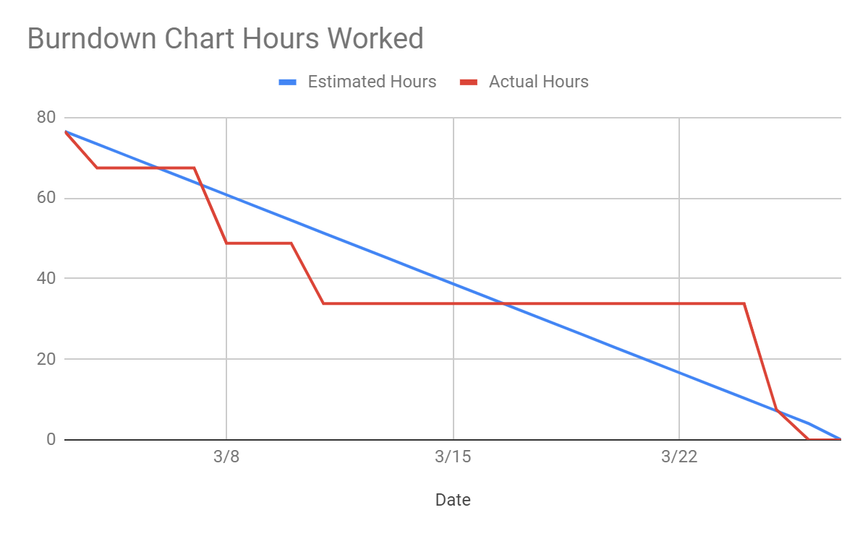
Burndown Chart – Hours Worked

Slide 6
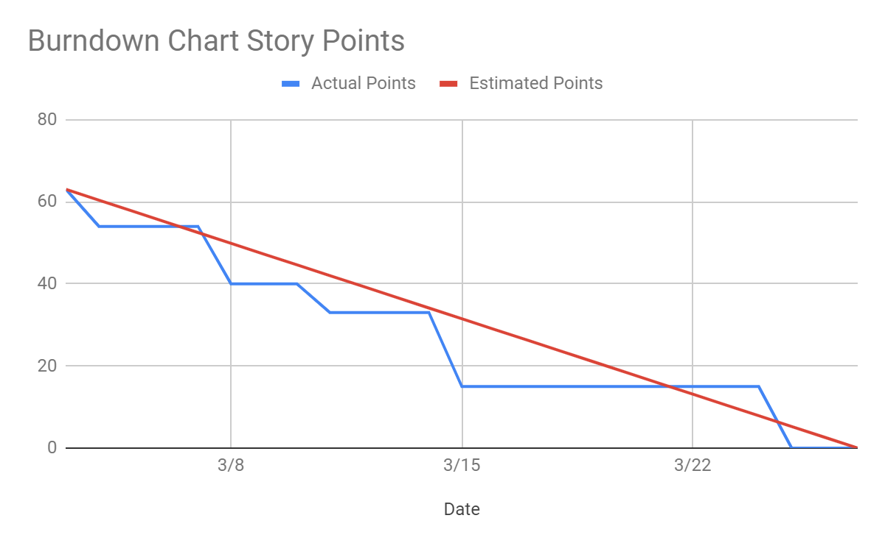
Burndown Chart – Story Points

Slide 7
Features for Sprint 1
File Upload
Announcements
Create, Edit, and Delete
Courses
Create, Edit, and Delete
Assignments
Create, Edit, and Delete
Responsive UI Navbar

Slide 8
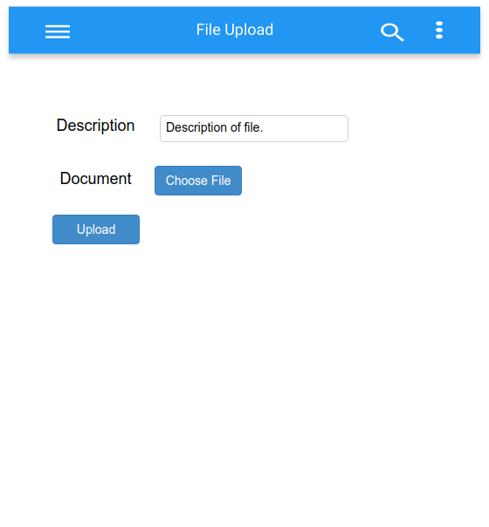
File List

Slide 9
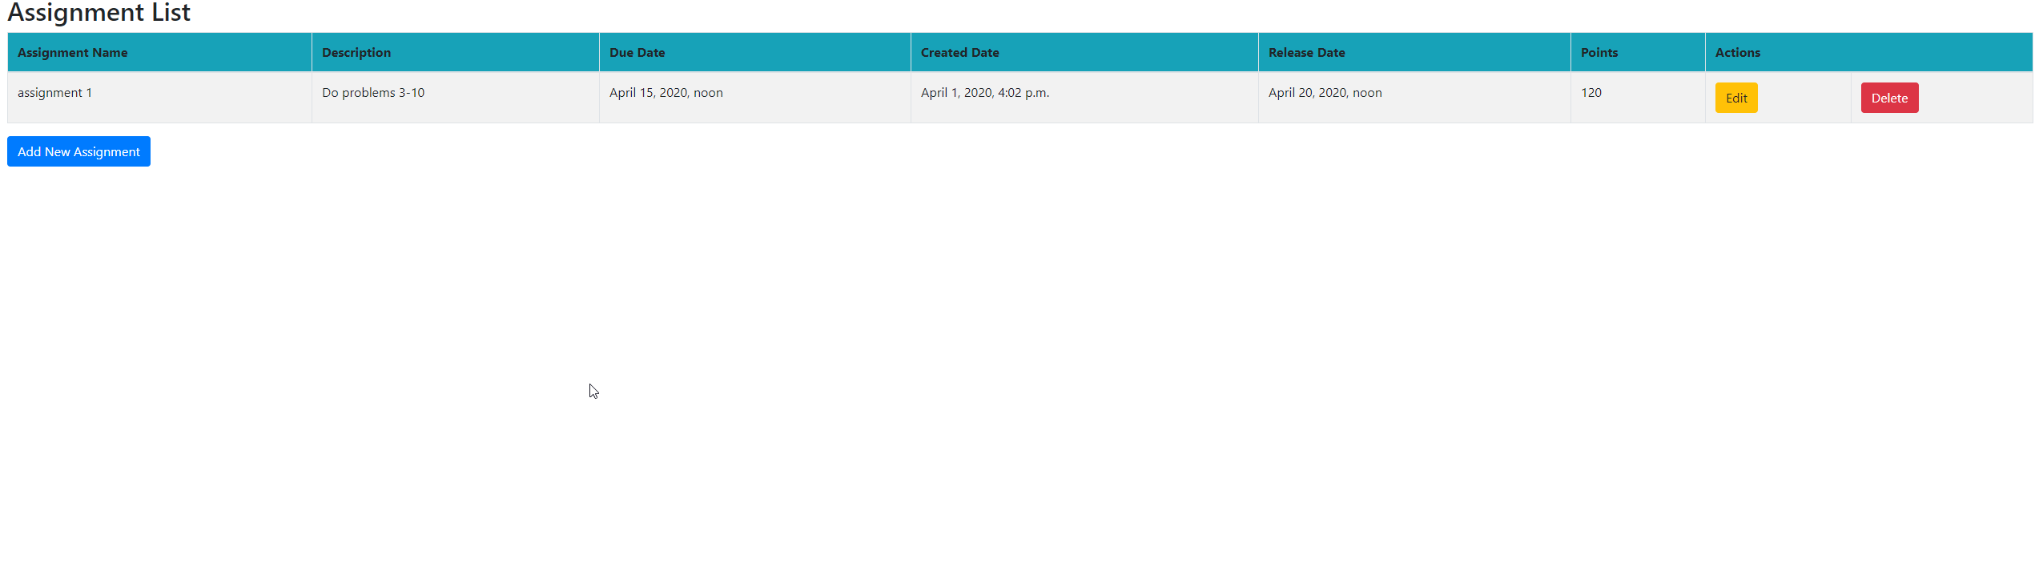
Assignment List

Slide 10
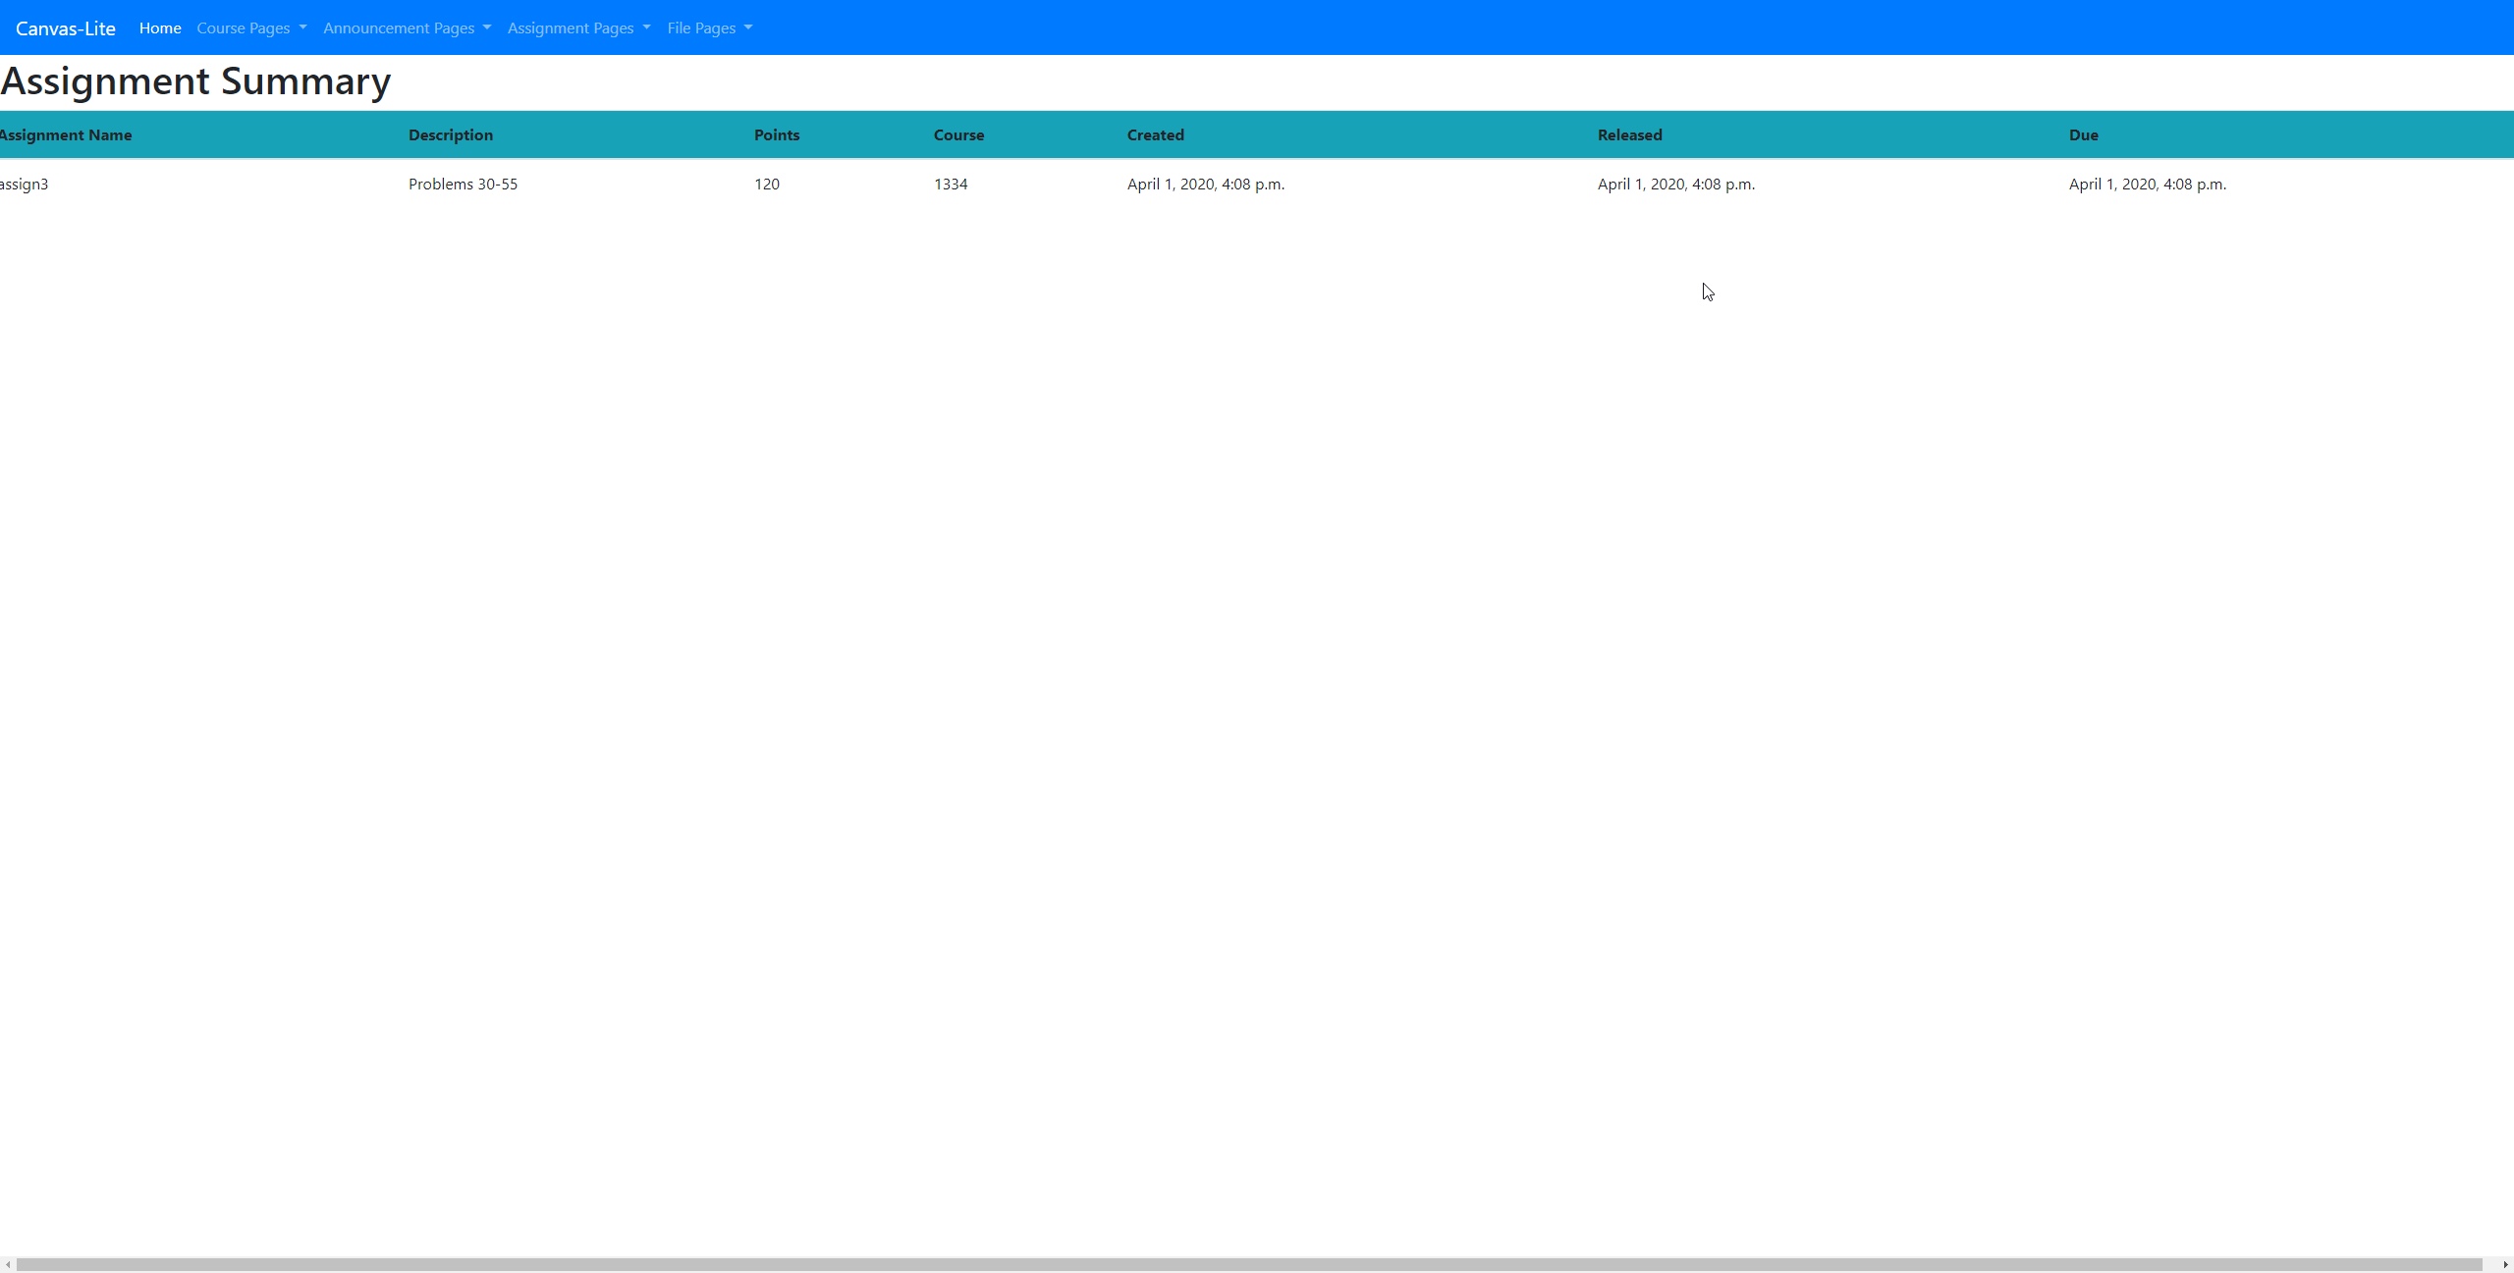
Assignment Summary

Slide 11
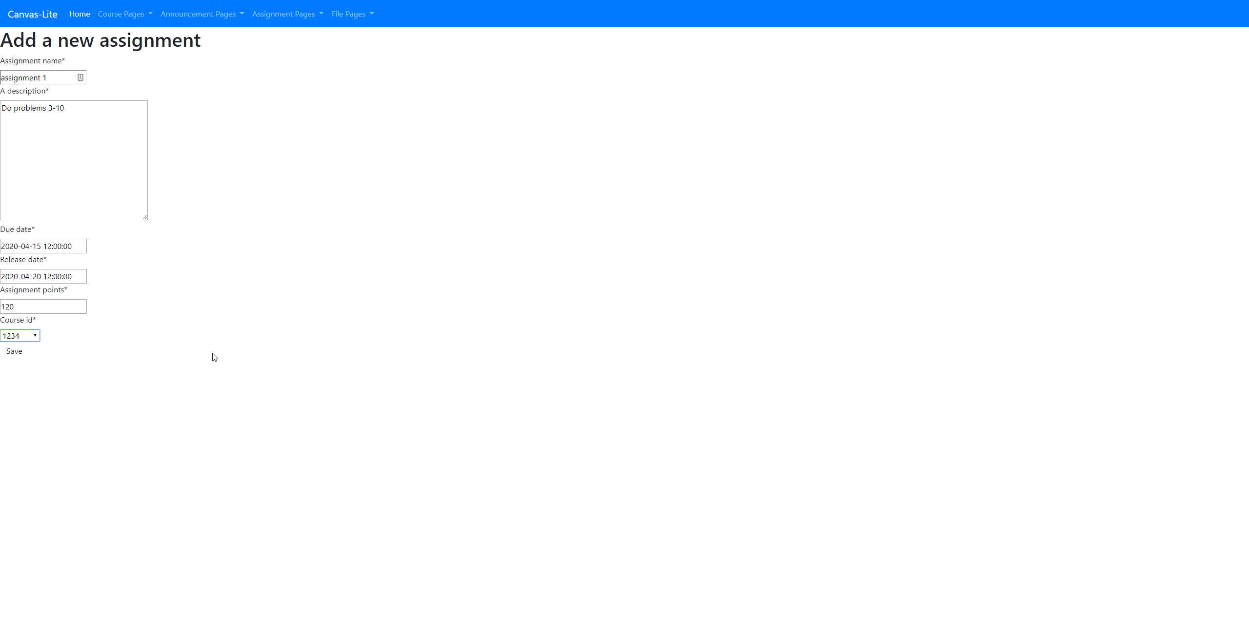
Assignment Add

Slide 12
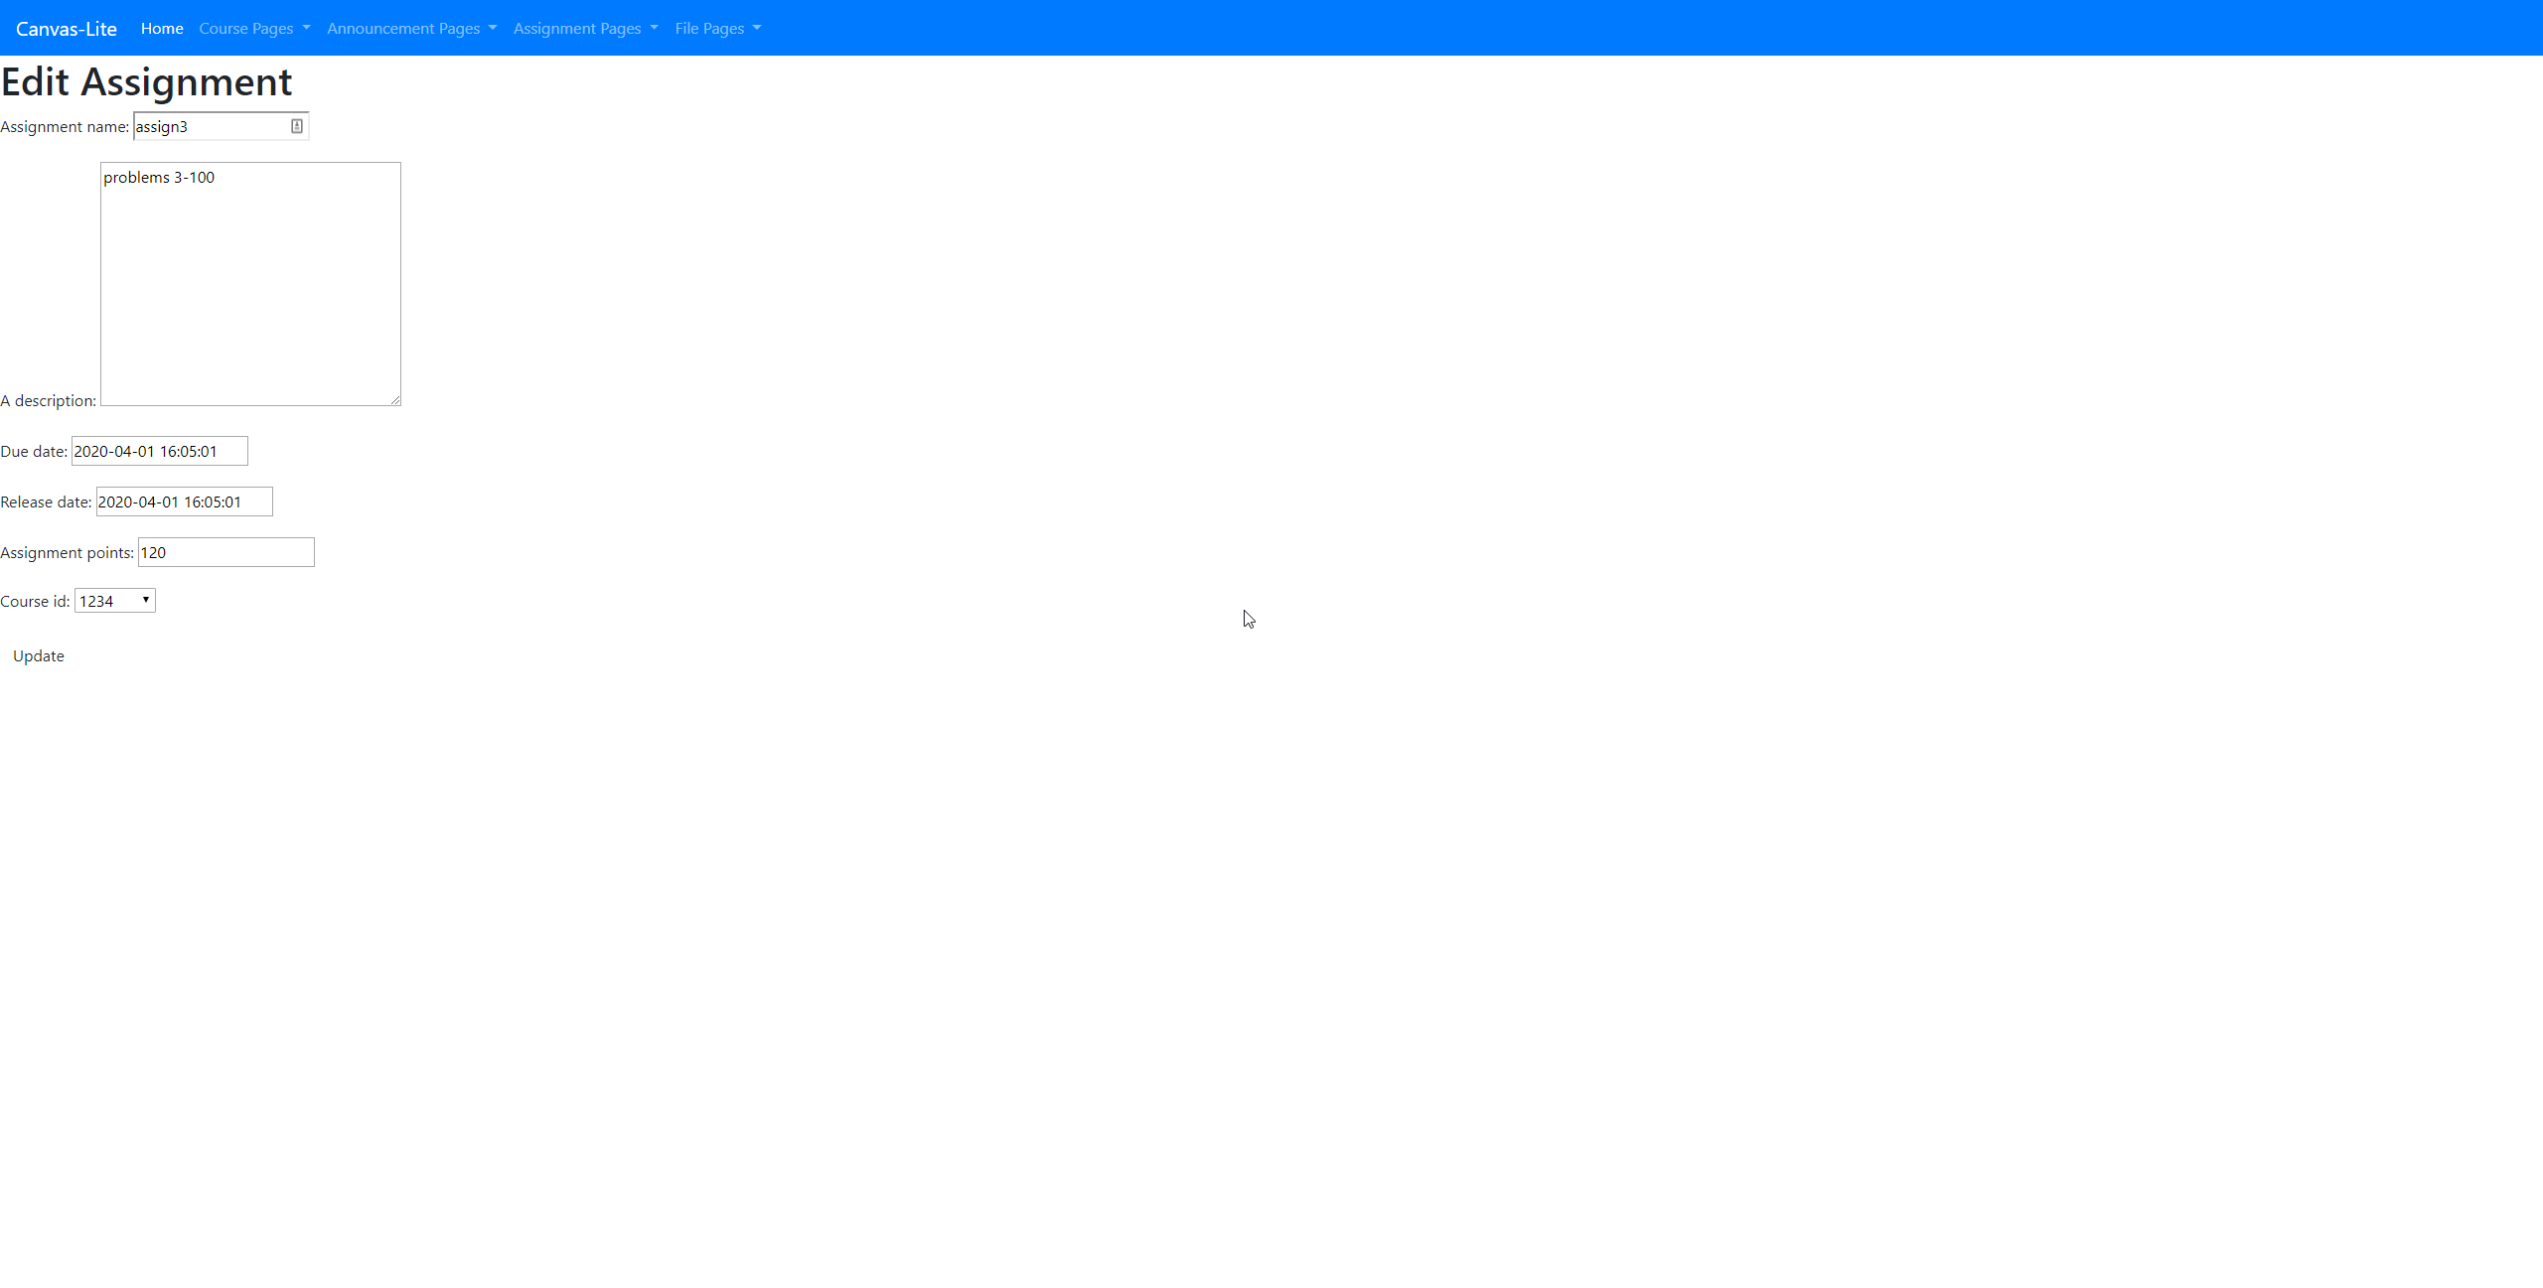
Assignment Edit

Slide 13
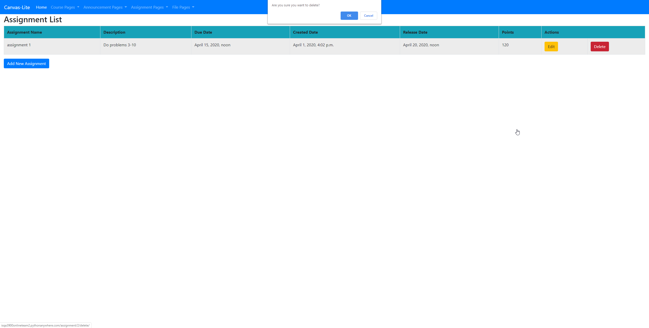
Assignment Delete

Slide 14
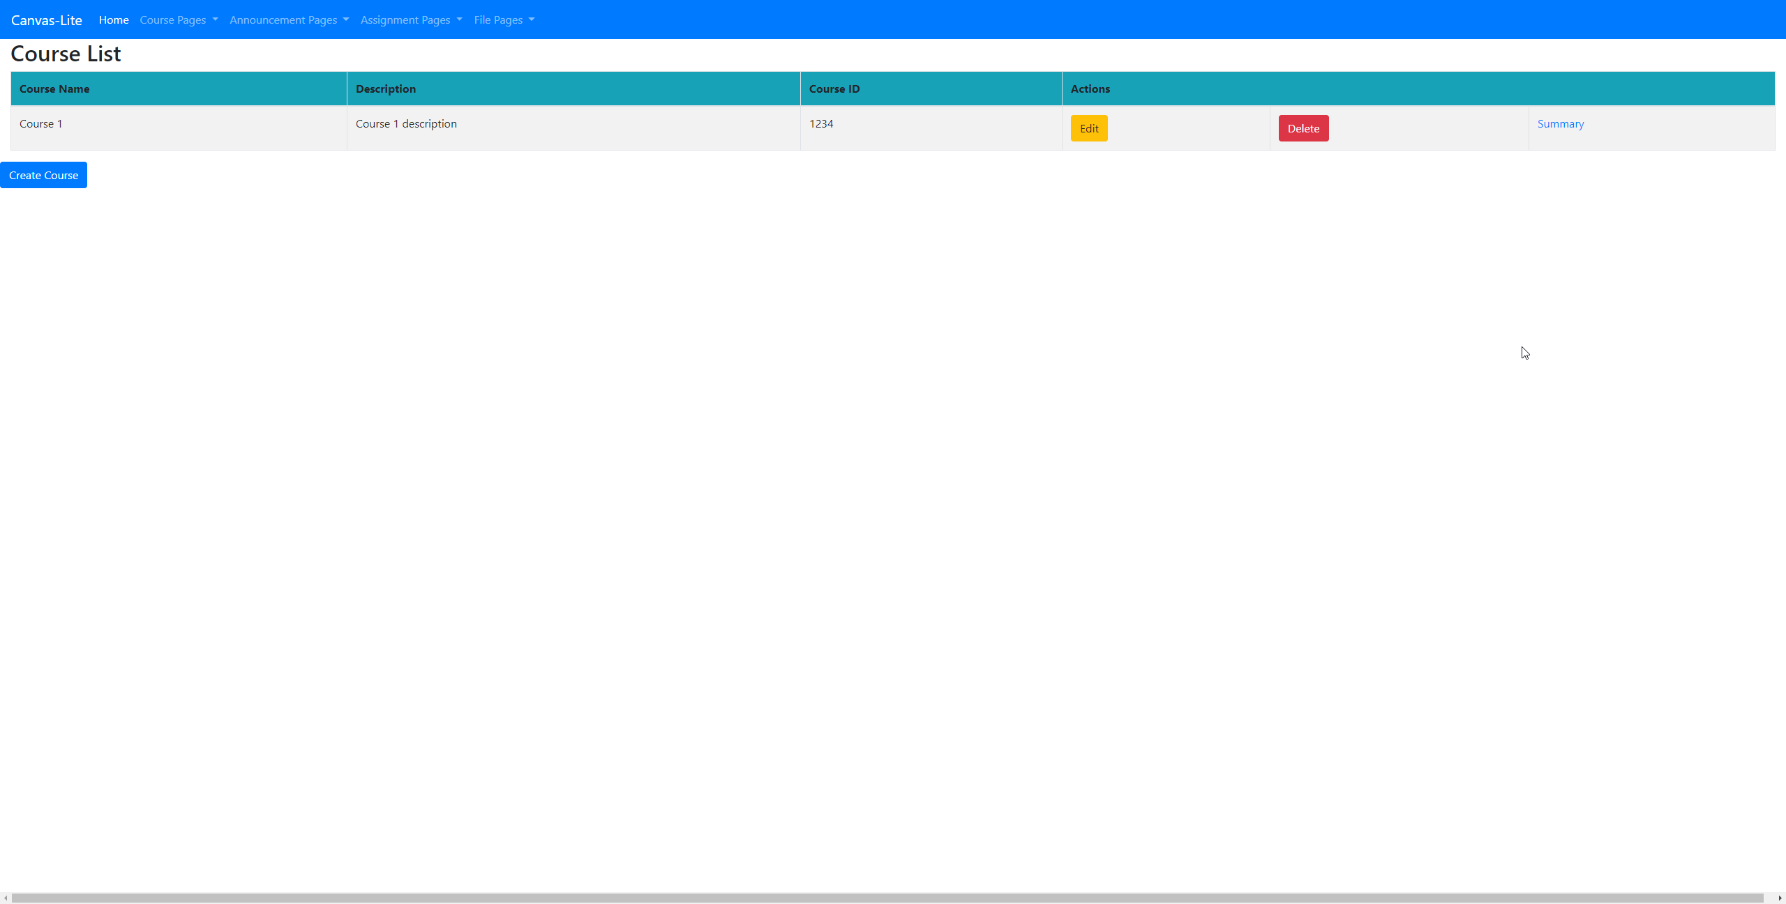
Course List

Slide 15
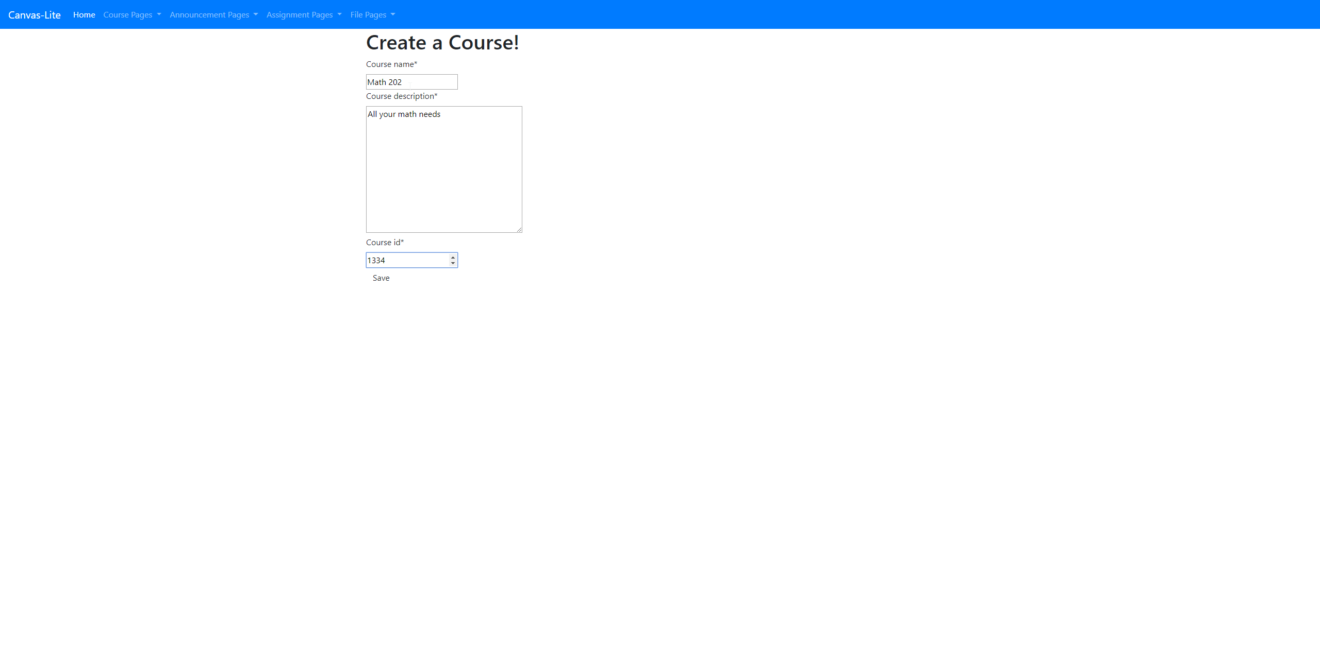
Course Add

Slide 16
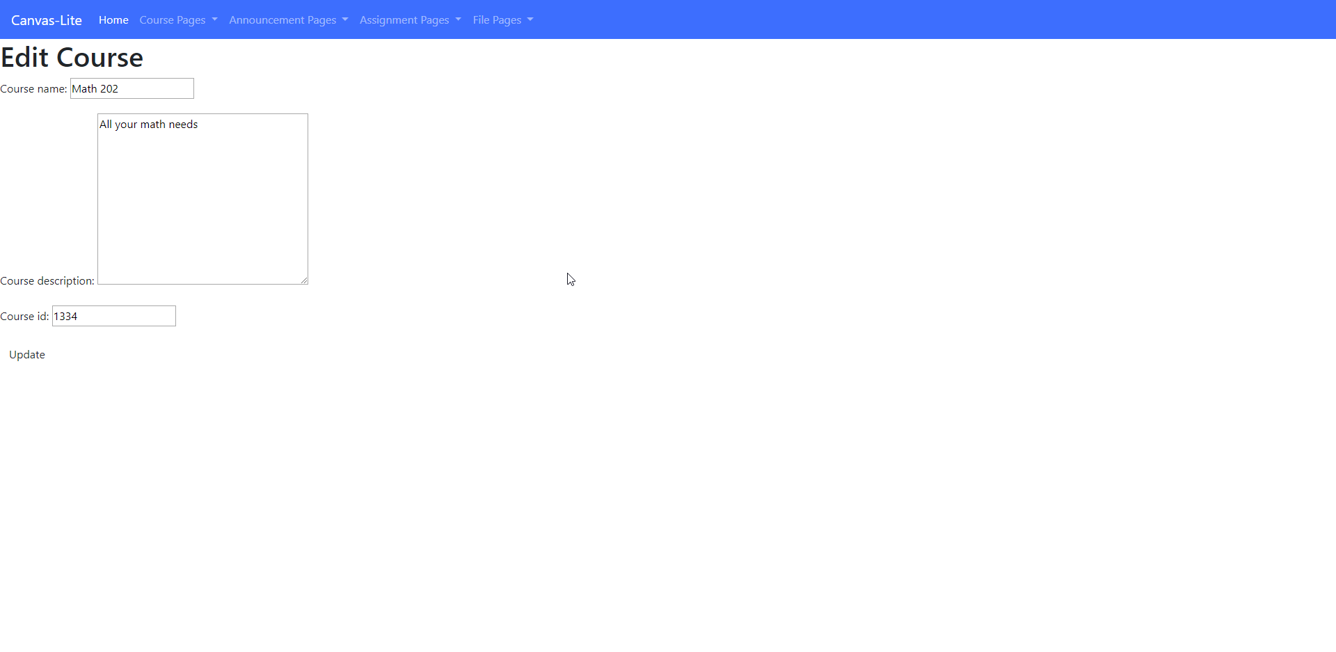
Course Edit

Slide 17
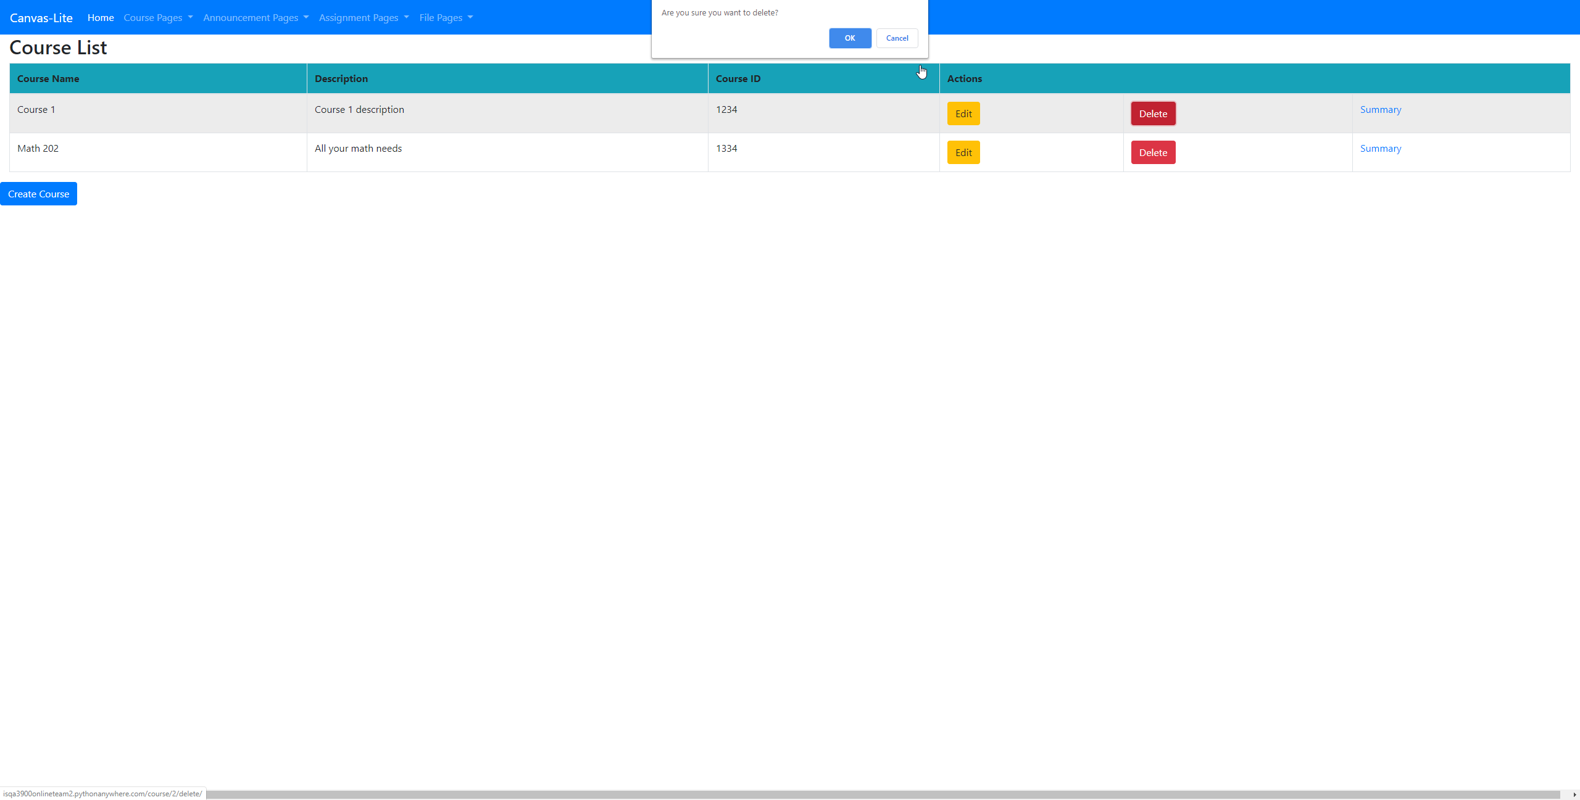
Course Delete

Slide 18
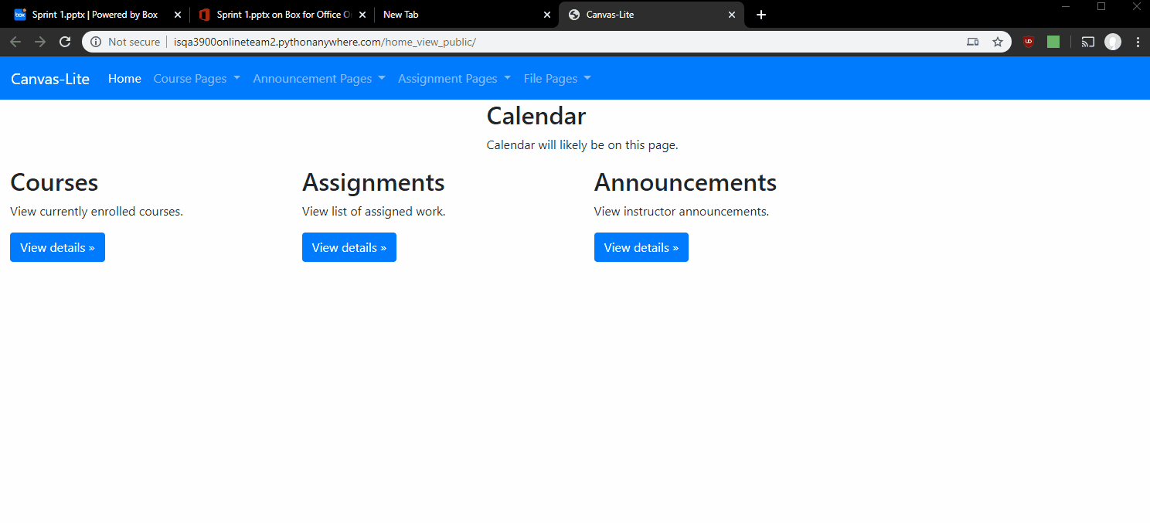
UI Design
Mockups of the application were designed with a smaller screen size.
To support this we will use responsive web design so the page elements will display on screens of all sizes.
We've implemented responsive web design using bootstrap.
In future sprints all page elements will be implemented with responsive design

Slide 19
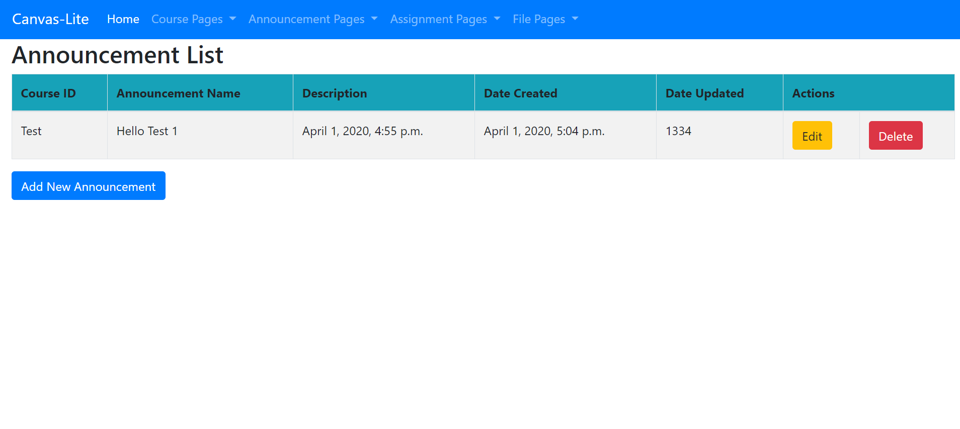
Announcements List
An announcements page that shows announcements.
Announcements can be viewed, created, edited, and deleted by anyone.
Access control will be implemented in the next sprint.

Slide 20
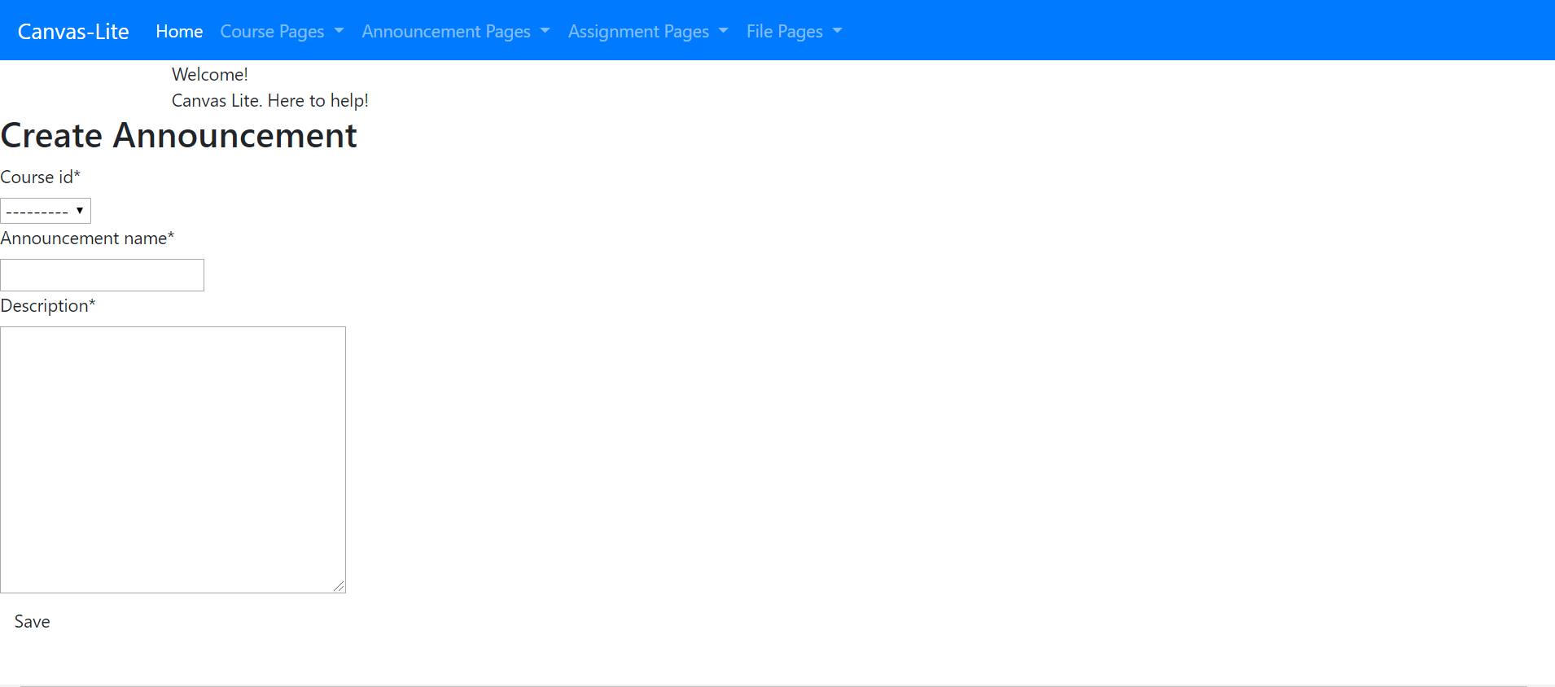
Create Announcements

Slide 21
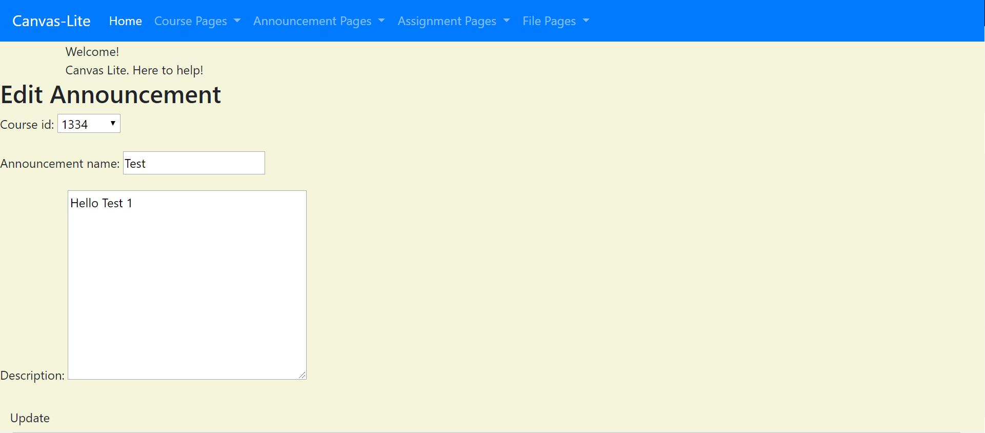
Edit Announcements

Slide 22
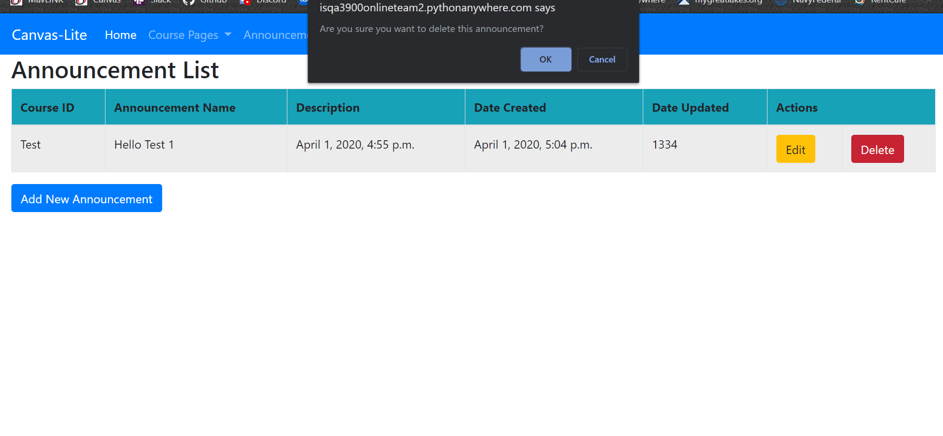
Delete Announcements

Slide 23
Features for Sprint 2
Roles
Access Control
Course Home Pages
Student assignment pages
Instructor Assignment pages
Improved UI
Improved Home Page
Student and Instructor Course lists

Slide 24
Mockups for Sprint 2

Slide 25
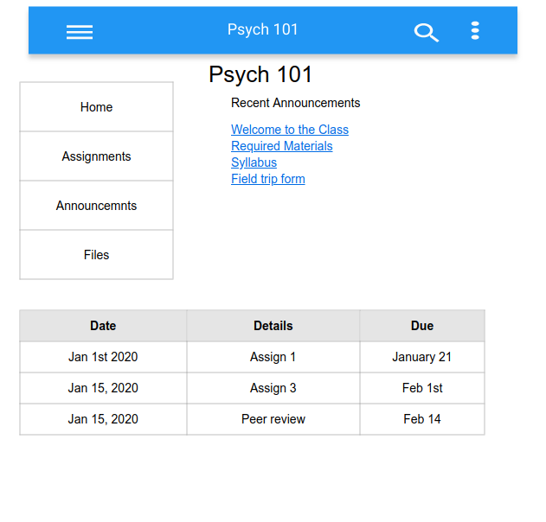
Course Home page

Slide 26
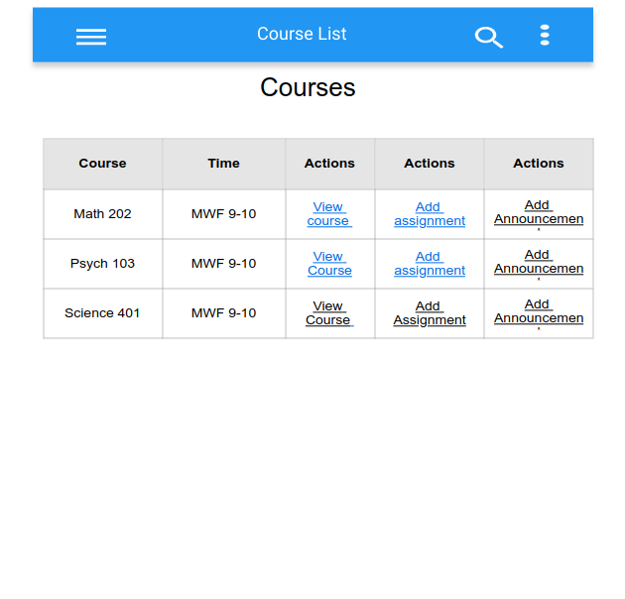
Instructor Course List

Slide 27
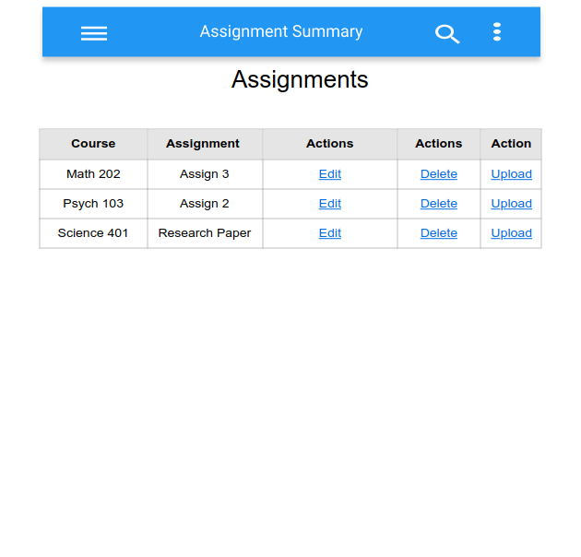
Instructor Assignment List

Slide 28
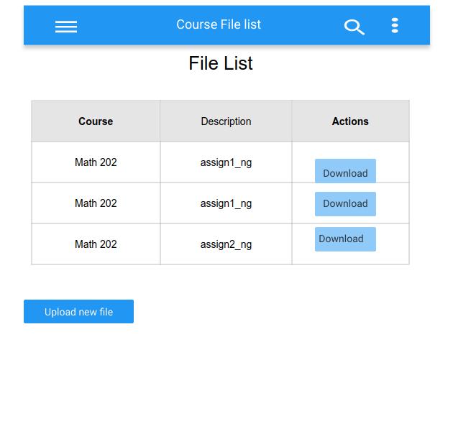
Instructor File List

Slide 29
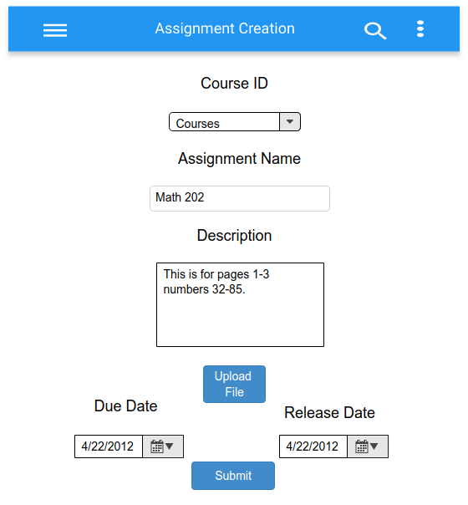
Assignment Creation Page

Slide 30
File Upload Page

Slide 31
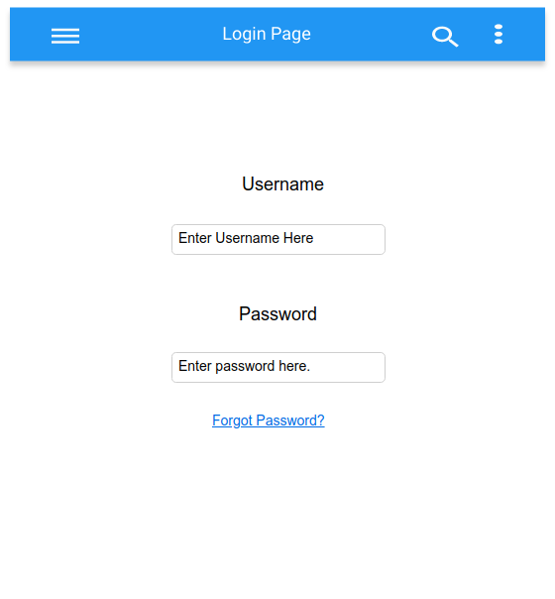
Login Page

Slide 32
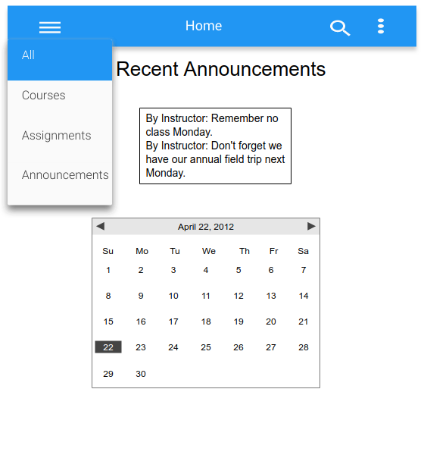
Updated Home Page

Slide 33
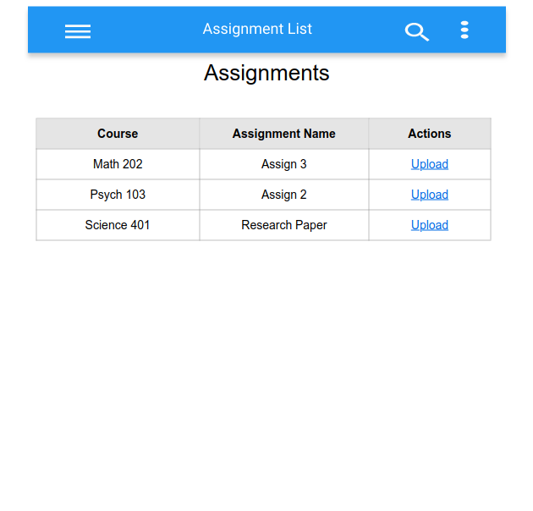
Student Assignment List

Slide 34
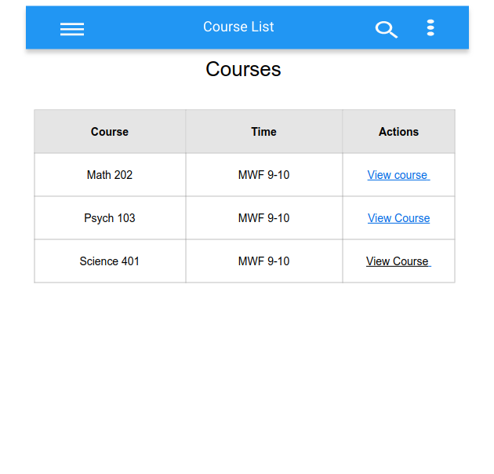
Student Course List

